Slide 1
SECURE DATA HIDING IN IMAGES USING STEGANOGRAPHY
CAPSTONE PROJECT
Presented By: JOKIKA V
Student Name : JOKIKA V
College Name & Department : BHARATHIAR UNIVERSITY.

Slide 2
OUTLINE
Problem Statement
Technology used
Wow factor
End users
Result
Conclusion
Git-hub Link
Future scope

Slide 3
Problem Statement
As data breaches and unauthorized access continue to rise, traditional encryption methods fall short of providing complete security. This project uses steganography to hide encrypted messages within images, offering an additional layer of protection by making the data itself undetectable and secure.

Slide 4
Technology used
Libraries:
os: Manages file handling and interaction with the operating system.
re: Validates strong passwords using regular expressions.
zlib: Compresses and decompresses data to reduce message size.
base64: Encodes passwords for secure storage.
tkinter: Creates the graphical user interface (GUI).
PIL (Pillow): Processes images (opening, modifying, and saving) to embed and extract messages.
cryptography.fernet: Provides strong encryption and decryption of messages.
ttkthemes: Enhances the GUI appearance with themed styles for user-friendly interaction.
Platforms:
Python: The programming language used to develop the application.
Windows: The operating systems where the application runs.

Slide 5
Wow factors
Strong Encryption:
Uses cryptography.fernet for secure encryption, ensuring message confidentiality and integrity.
Data Compression:
Compresses messages with zlib to save space and optimize storage.
User-Friendly GUI:
Built with tkinter and ttkthemes for easy interaction, accessible to users of all skill levels.
Password Validation:
Enforces strong password policies with re, requiring complex passwords for added security.
Cross-Platform Compatibility:
Runs on Windows and Linux, ensuring broad accessibility and usability.
Dual-layer Security:
Combines encryption and steganography for enhanced protection.
Password Protection:
Ensures only authorized users can retrieve hidden messages.
Compression for Efficiency:
Optimizes storage space by reducing message size before embedding.
Image Format Support:
Works seamlessly with PNG and JPEG images.

Slide 6
End users
Day-to-Day Users:
Privacy-Conscious Individuals: Hide sensitive personal data such as passwords or confidential notes within images.
Journalists & Whistleblowers: Securely transmit confidential information while avoiding detection.
Corporate Sector: Protect intellectual property, business plans, and classified documents from unauthorized access.
Students & Researchers: Securely store academic data, research findings, and personal notes within images.
Confidential & High-Security Users:
Government & Military: Covert communication to prevent intelligence leaks and cyber-espionage.
Law Enforcement Agencies: Secure exchange of investigation details, witness protection details, and classified reports.
Cybersecurity Professionals: Hide sensitive credentials and access logs to prevent cyberattacks.
Defense & Intelligence Organizations: Safeguard national security information and classified operations.

Slide 7
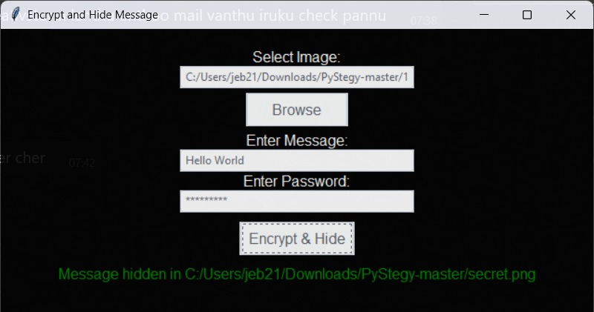
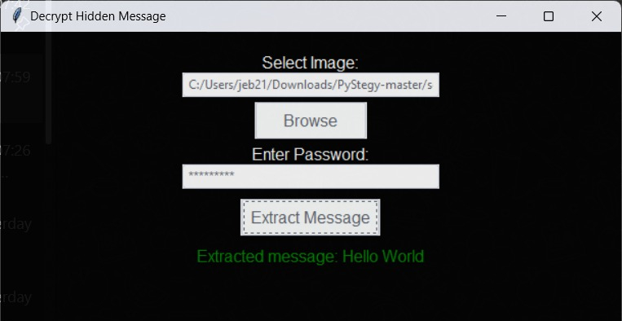
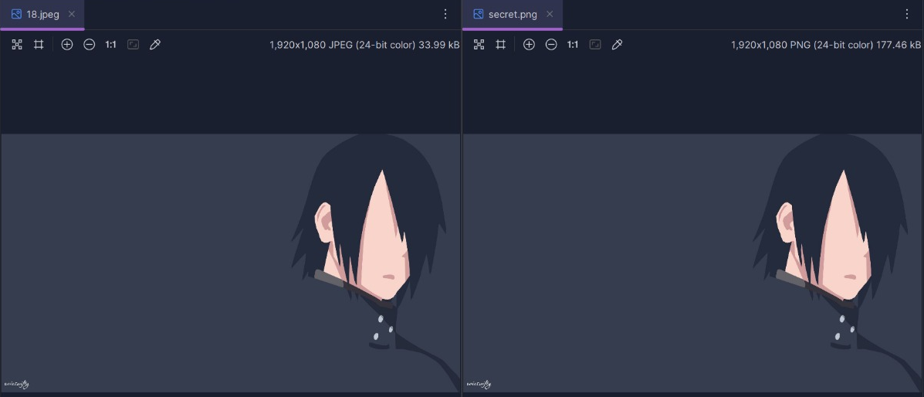
Results

Slide 8
Conclusion
This project implements steganography to provide a secure and covert method for concealing sensitive data within images. By integrating strong encryption (Fernet) with image-based data hiding, it establishes a dual-layer security mechanism—first encrypting the message and then embedding it within an image file.
The solution offers several key advantages, including enhanced security, stealth & undetectability, optimized storage, and a user-friendly interface, making it a robust choice for individuals and organizations requiring secure and discreet information transfer.
This method has practical applications across various fields, such as personal data protection, corporate security, journalism, military intelligence, and law enforcement.
Overall, this project successfully demonstrates an effective and user-friendly approach to secure data concealment, ensuring safer communication in an era of growing digital threats.

Slide 9
GitHub Link
https://github.com/Jokika11/Secure-Data-Hiding-in-Image-Using-Steganography.git

Slide 10
THANK YOU

